Slide 1

Department of Computer Science
University Institute of Engineering
DEPARTMENT OF COMPUTER SCIENCE & ENGINEERING
Bachelor of Engineering
Subject Name: System Programming
Subject Code: CST-315
Assemblers
DISCOVER . LEARN . EMPOWER

Slide 2
Chapter-1.2 Assemblers
Department of computer Science
Single pass Assembler for Intel x86
Algorithm of Single Pass Assembler

Slide 3
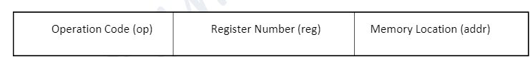
Chapter-1.2 Assemblers
Department of computer Science
The CPU consists of an instruction interpreter, a location counter, an instruction register and various working registers and general registers.
Example:
To illustrate how these components of the machine structure interact, let us consider a simple computer (SC-6251). The SC-6251 has four general registers, designated 00, 01, 10 and 11 in the binary notation.
The instruction format is as follows:
For example, the instruction ADDR 2, 176 Would cause the data stored in memory location 176 to be added to the current contents of the general register 2. The resulting sum would be left as the new contents of register 2.

Slide 4
Chapter-1.2 Assemblers
Department of computer Science
MEMORY
The basic unit of memory is a byte- 8 bits of information, i.e, each addressable position in memory can contain eight bits of information.
BYTE 1 BYTE 8 BITS
HALFWORD 2 BYTES 16 BITS
WORD 4 BYTES 32 BITS
DOUBLEWORD 8 BYTES 64 BITS
The size of memory is up to 2²⁴ bytes

Slide 5
Chapter-1.2 Assemblers
Department of computer Science
Advantages of assembly language
Since mnemonics replace machine instruction it is easy to write, debug and understand in comparison to machine codes.
Useful to write lightweight application (in embedded system like traffic light) because it needs fewer codes than high level language.
Disadvantages of assembly language
Mnemonics in assembly language are in abbreviated form and in large number, so they are hard to remember.
Program written in assembly language are machine dependent, so are incompatible for different type of machines.
A program written in assembly language is less efficient to same program in machine language.
Mnemonics can be different for different machines according to manufacturer’s so assembly language suffers from the defect of non-standardization

Slide 6
Chapter-1.2 Assemblers
Department of computer Science
ELEMENTS OF ASSEMBLY LANGUAGE PROGRAMMING
An assembly language provides the following five basic facilities that simplifies programming:
Mnemonic operation code: A small word that acts as an identifier for the instruction. The mnemonics are written in code segment. In following examples mov, sub, add, jmp, call, and mul are the mnemonics
a. MOV Move/assign one value to another (label)
b. SUB Subtract one value from another
c. ADD Adds two values
d. JMP Jump to a specific location
e. CALL Call a procedure/module
f. MUL Multiply two values
g. Example: ADD R1, R2

Slide 7
Chapter-1.2 Assemblers
Department of computer Science
2. Symbols / Labels: Symbols or labels are just like variables in any other language.
Example int a=5; Symbol table is used to handle such things
3. Data declarations: Data can be declared in a variety of notations, including the decimal notation. It avoids the need to manually specify constants in representations that a computer can understand, for example, specify -5 as (11111011)
4. Location Counter (LC): Indicate next instruction to be executed
5. Literals: Constant value.
Example: R1=a+8, 8 is literal. Literals are stored in literal table data structure.

Slide 8
Chapter-1.2 Assemblers
Department of computer Science
ASSEMBLY LANGUAGE STATEMENTS
Imperative Statements: indicates an action to be performed during the execution of the assembled program.
Each imperative statement typically translates into one machine instruction.
2. Declaration Statements: the syntax of declaration statements is:
[Label] DS
[Label] DC
The DS (short) for declare storage statement reserves areas of memory and associates names with them .e.g.
A DS 1 The above statement reserves a memory area of 1 word and associates the name A with it.
The DC (short for declare constant) statement declare memory words containing constants.
3. Assembler Directives: Assembler directives are Pseudo-Instructions. They provide instructions to the assembler itself. They are not translated into machine operation codes

Slide 9
Chapter-1.2 Assemblers
Department of computer Science
Basic assembler directives are:
ASSUME (The ASSUME directive is used to tell the assembler that the name of the logical segment should be used for a specified segment.)
DB - Defined Byte (DB directive is used to declare a byte type variable or to store a byte in memory location)
DD - Defined Double Word
DQ - Defined Quad Word
DT - Define Ten Byte

Slide 10
Chapter-1.2 Assemblers
Department of computer Science
DATA STRUCTURE/TABLES USED BY ASSEMBLER
1. Machine-Opcode Table (MOT) or (Operation Code Table) or Mnemonics table :
A mnemonic is an abbreviation for an operation.
This table consists of the fields: Name of mnemonic, binary value, instruction length, format of instruction.
MOT table is used to look up mnemonic operation codes and translate them to their machine language equivalents

Slide 11
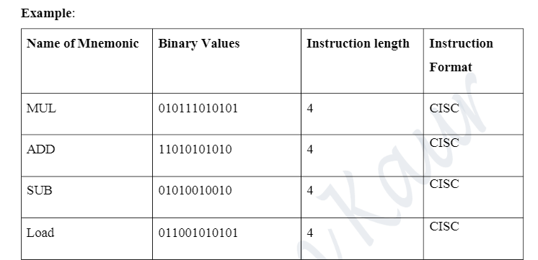
Chapter-1.2 Assemblers
Department of computer Science
Machine-Opcode Table (MOT) or (Operation Code Table) or Mnemonics table

Slide 12
Chapter-1.2 Assemblers
Department of computer Science
DATA STRUCTURE/TABLES USED BY ASSEMBLER
2. Pseudo Opcode Table (POT):
This table consists of the fields:
Name of Pseudo code
Action associated with Pseudo code.
POT is the fixed length table. This direct assembler what action should be taken corresponding to any pseudo code given in the program.

Slide 13
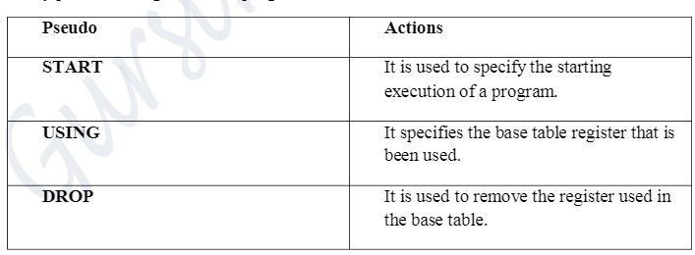
Chapter-1.2 Assemblers
Department of computer Science
Pseudo Opcode Table (POT)

Slide 14
Chapter-1.2 Assemblers
Department of computer Science
DATA STRUCTURE/TABLES USED BY ASSEMBLER
3. Symbol Table (ST)
Symbol table is used for keeping the track of symbol that are defined in the program.
It is used to give a location for a symbol specified.
The assembler creates the symbol table section for the object file. It makes an entry in the symbol table for each symbol that is defined or referenced in the input file and is needed during linking
• In pass 1, whenever a symbol is defined corresponding entry is made in symbol table.
• In pass2, symbol table is used for generating machine code of a symbol.

Slide 15
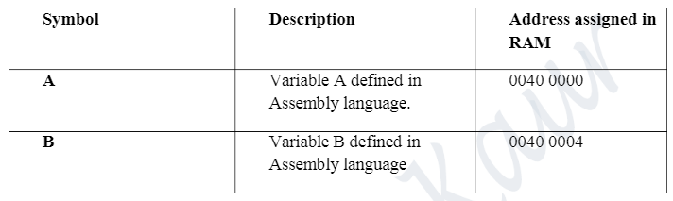
Chapter-1.2 Assemblers
Department of computer Science
Symbol Table

Slide 16
Chapter-1.2 Assemblers
Department of computer Science
DATA STRUCTURE/TABLES USED BY ASSEMBLER
4. Literal Table (LT)
Literal table is used for keeping track of literals that are encountered in the programs.
• We directly specify the value, literal is used to give a location for the value.
• In pass 1, whenever a Literal is defined and for entry is made in Literal table.
• In pass2, Literal table is used for generating binary code of a Literal.
Literals are always encountered in the operand field of an instruction.

Slide 17
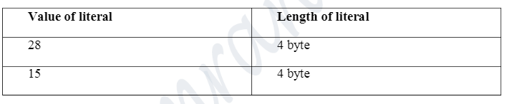
Chapter-1.2 Assemblers
Department of computer Science
Literal Table

Slide 18
Chapter-1.2 Assemblers
Department of computer Science
DATA STRUCTURE/TABLES USED BY ASSEMBLER
5. Base Table (BT)
This store the information of available register in hardware of the system. Example, Register1 is free but R2 and R3 are not free.
Register | Available
R1 | Free
R2 | Not Free
R3 | Not Free

Slide 19
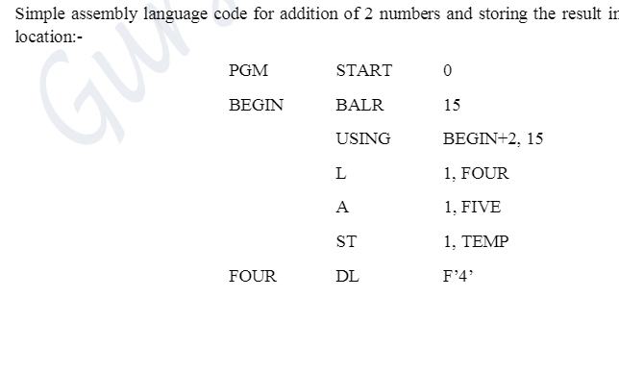
FIVE DC F’3’
TEMP DS 1F
END

Slide 20
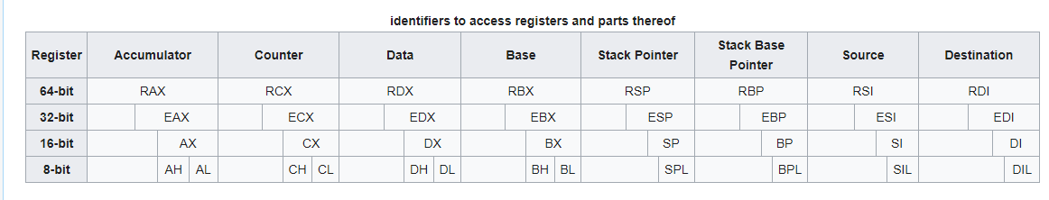

Slide 21
Single pass Assembler for Intel x86
General-Purpose Registers (GPR) - 16-bit naming conventions
The 8 GPRs are as follows:
Accumulator register (AX). Used in arithmetic operations
Counter register (CX). Used in shift/rotate instructions and loops.
Data register (DX). Used in arithmetic operations and I/O operations.
Base register (BX). Used as a pointer to data (located in segment register DS, when in segmented mode).
Stack Pointer register (SP). Pointer to the top of the stack.
Stack Base Pointer register (BP). Used to point to the base of the stack.
Source Index register (SI). Used as a pointer to a source in stream operations.
Destination Index register (DI). Used as a pointer to a destination in stream operations.

Slide 22
Single pass Assembler for Intel x86
The 6 Segment Registers are:
Stack Segment (SS). Pointer to the stack ('S' stands for 'Stack').
Code Segment (CS). Pointer to the code ('C' stands for 'Code').
Data Segment (DS). Pointer to the data ('D' comes after 'C').
Extra Segment (ES). Pointer to extra data ('E' stands for 'Extra').
F Segment (FS). Pointer to more extra data ('F' comes after 'E').
G Segment (GS). Pointer to still more extra data ('G' comes after 'F').

Slide 23
Single pass Assembler for Intel x86
Labels
• Act as place markers
• marks the address (offset) of code and data
• Easier to memorize and more flexible
eg. mov ax, [0020]→mov ax, val
• Follow identifier rules
Data label
• must be unique
example: myArray BYTE 10
• Code label (ends with a colon)
• target of jump and loop instructions
example: L1: mov ax, bx ... jmp L1

Slide 24
Single pass Assembler for Intel x86
Reserved words and identifiers
• Reserved words cannot be used as identifiers
•Instruction mnemonics, directives, type attributes, operators, predefined symbols
• Identifiers
• 1-247 characters, including digits
• case insensitive (by default)
• first character must be a letter, _, @, or $
examples: var1 Count $first _main MAX open_file @@myfile xVal _12345

Slide 25
Single pass Assembler for Intel x86
Comments • Comments are good! • explain the program's purpose • tricky coding techniques • application-specific explanations • Single-line comments • begin with semicolon (;) • block comments • begin with COMMENT directive and a programmer-chosen character and end with the same programmer-chosen character COMMENT ! This is a comment and this line is also a comment !
directive marking a comment comment copy definitions from Irvine32.inc code segment. 3 segments: code, data, stack beginning of a procedure destination source defined in Irvine32.inc to end a program marks the last line and define the startup procedure Example: adding/subtracting integers TITLE Add and Subtract (AddSub.asm) ; This program adds and subtracts 32-bit integers.
Defining data
Intrinsic data types (1 of 2) • BYTE, SBYTE • 8-bit unsigned integer; 8-bit signed integer • WORD, SWORD • 16-bit unsigned & signed integer • DWORD, SDWORD • 32-bit unsigned & signed integer • QWORD • 64-bit integer • TBYTE • 80-bit integer
Intrinsic data types (2 of 2) • REAL4 • 4-byte IEEE short real • REAL8 • 8-byte IEEE long real • REAL10 • 10-byte IEEE extended real
Data definition statement • A data definition statement sets aside storage in memory for a variable. • May optionally assign a name (label) to the data. • Only size matters, other attributes such as signed are just reminders for programmers. • Syntax: [name] directiveinitializer [,initializer] . . . At least one initializer is required, can be ? • All initializers become binary data in memory
Integer constants • [{+|-}] digits [radix] • Optional leading + or – sign • binary, decimal, hexadecimal, or octal digits • Common radix characters: • h– hexadecimal • d– decimal (default) • b– binary • r– encoded real • o– octal Examples: 30d, 6Ah, 42, 42o, 1101b Hexadecimal beginning with letter: 0A5h

Slide 26
Single pass Assembler for Intel x86
Integer expressions • Operators and precedence levels: • Examples:
Real number constants (encoded reals) • Fixed point v.s. floating point • Example 3F800000r=+1.0,37.75=42170000r • double 1 8 23 S E M ±1.bbbb×2 (E-127) 1 11 52 S E M
Real number constants (decimal reals) • [sign]integer.[integer][exponent] sign → {+|-} exponent → E[{+|-}]integer • Examples: 2. +3.0 -44.2E+05 26.E5
Character and string constants • Enclose character in single or double quotes • 'A', "x" • ASCII character = 1 byte • Enclose strings in single or double quotes • "ABC" • 'xyz' • Each character occupies a single byte • Embedded quotes: • ‘Say "Goodnight," Gracie’ • "This isn't a test"
Defining BYTE and SBYTE Data Each of the following defines a single byte of storage: value1 BYTE 'A‘ ; character constant value2 BYTE 0 ; smallest unsigned byte value3 BYTE 255 ; largest unsigned byte value4 SBYTE -128 ; smallest signed byte value5 SBYTE +127 ; largest signed byte value6 BYTE ? ; uninitialized byte A variable name is a data label that implies an offset (an address).
Defining multiple bytes Examples that use multiple initializers: list1 BYTE 10,20,30,40 list2 BYTE 10,20,30,40 BYTE 50,60,70,80 BYTE 81,82,83,84 list3 BYTE ?,32,41h,00100010b list4 BYTE 0Ah,20h,‘A’,22h
Defining strings (1 of 2) • A string is implemented as an array of characters • For convenience, it is usually enclosed in quotation marks • It usually has a null byte at the end • Examples: str1 BYTE "Enter your name",0 str2 BYTE 'Error: halting program',0 str3 BYTE 'A','E','I','O','U' greeting1 BYTE "Welcome to the Encryption Demo program " BYTE "created by Kip Irvine.",0 greeting2 \ BYTE "Welcome to the Encryption Demo program " BYTE "created by Kip Irvine.",0
Defining strings (2 of 2) • End-of-line character sequence: • 0Dh = carriage return • 0Ah = line feed str1 BYTE "Enter your name: ",0Dh,0Ah BYTE "Enter your address: ",0 newLine BYTE 0Dh,0Ah,0 Idea: Define all strings used by your program in the same area of the data segment.

Slide 27
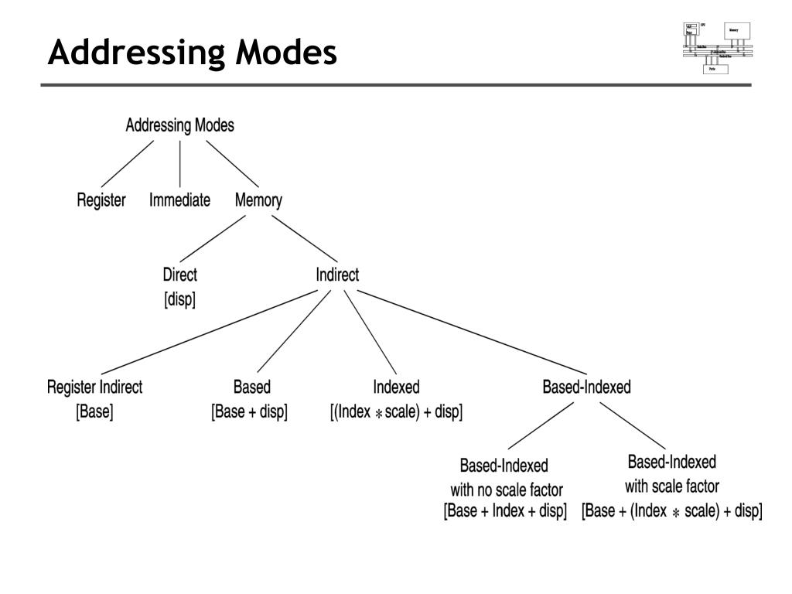
Single pass Assembler for Intel x86

Slide 28
Chapter-1.2 Assemblers
Department of computer Science
Assembly - Addressing Modes
Most assembly language instructions require operands to be processed. An operand address provides the location, where the data to be processed is stored. Some instructions do not require an operand, whereas some other instructions may require one, two, or three operands.
When an instruction requires two operands, the first operand is generally the destination, which contains data in a register or memory location and the second operand is the source. Source contains either the data to be delivered (immediate addressing) or the address (in register or memory) of the data. Generally, the source data remains unaltered after the operation.
The three basic modes of addressing are −
1. Register addressing
2. Immediate addressing
3. Memory addressing

Slide 29
Chapter-1.2 Assemblers
Department of computer Science
1. Register Addressing
In this addressing mode, a register contains the operand. Depending upon the instruction, the register may be the first operand, the second operand or both.
For example,
MOV DX, TAX_RATE ; Register in first operand
MOV COUNT, CX ; Register in second operand
MOV EAX, EBX ; Both the operands are in registers
As processing data between registers does not involve memory, it provides fastest processing of data.

Slide 30
Chapter-1.2 Assemblers
Department of computer Science
2. Immediate Addressing
An immediate operand has a constant value or an expression. When an instruction with two operands uses immediate addressing, the first operand may be a register or memory location, and the second operand is an immediate constant. The first operand defines the length of the data.
For example,
BYTE_VALUE DB 150 ; A byte value is defined
WORD_VALUE DW 300 ; A word value is defined
ADD BYTE_VALUE, 65 ; An immediate operand 65 is added
MOV AX, 45H ; Immediate constant 45H is transferred to AX

Slide 31
Chapter-1.2 Assemblers
Department of computer Science
3. Direct Memory Addressing
When operands are specified in memory addressing mode, direct access to main memory, usually to the data segment, is required. This way of addressing results in slower processing of data. To locate the exact location of data in memory, we need the segment start address, which is typically found in the DS register and an offset value. This offset value is also called effective address.
In direct addressing mode, the offset value is specified directly as part of the instruction, usually indicated by the variable name. The assembler calculates the offset value and maintains a symbol table, which stores the offset values of all the variables used in the program.

Slide 32
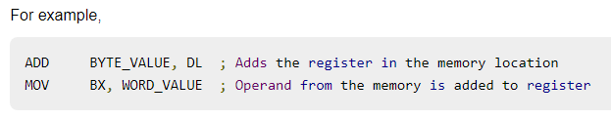
Chapter-1.2 Assemblers
Department of computer Science
3. Direct Memory Addressing
In direct memory addressing, one of the operands refers to a memory location and the other operand references a register.

Slide 33
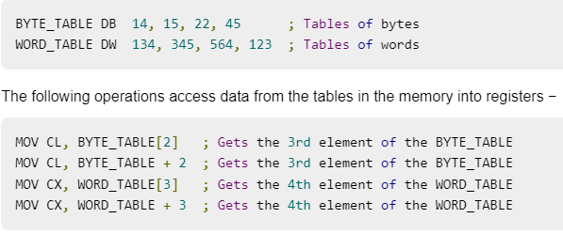
Chapter-1.2 Assemblers
Department of computer Science
Direct-Offset Addressing
This addressing mode uses the arithmetic operators to modify an address. For example, look at the following definitions that define tables of data

Slide 34
Chapter-1.2 Assemblers
Department of computer Science
4. Indirect Memory Addressing
This addressing mode utilizes the computer's ability of Segment: Offset addressing.
Generally, the base registers EBX, EBP (or BX, BP) and the index registers (DI, SI), coded within square brackets for memory references, are used for this purpose.
Indirect addressing is generally used for variables containing several elements like, arrays.
Starting address of the array is stored in, say, the EBX register.
The following code snippet shows how to access different elements of the variable.

Slide 35
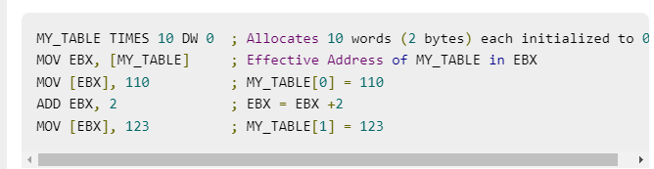
Chapter-1.2 Assemblers
Department of computer Science

Slide 36
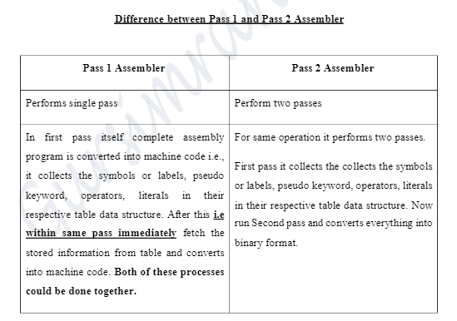
Chapter-1.2 Assemblers
Department of computer Science

Slide 37
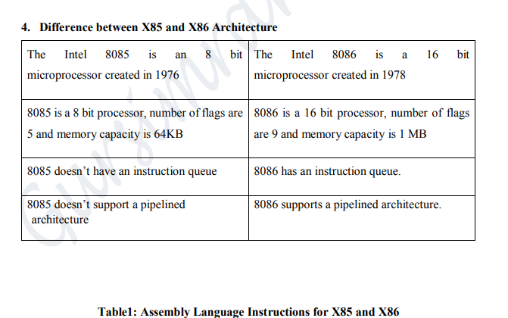
Chapter-1.2 Assemblers
Department of computer Science

Slide 38
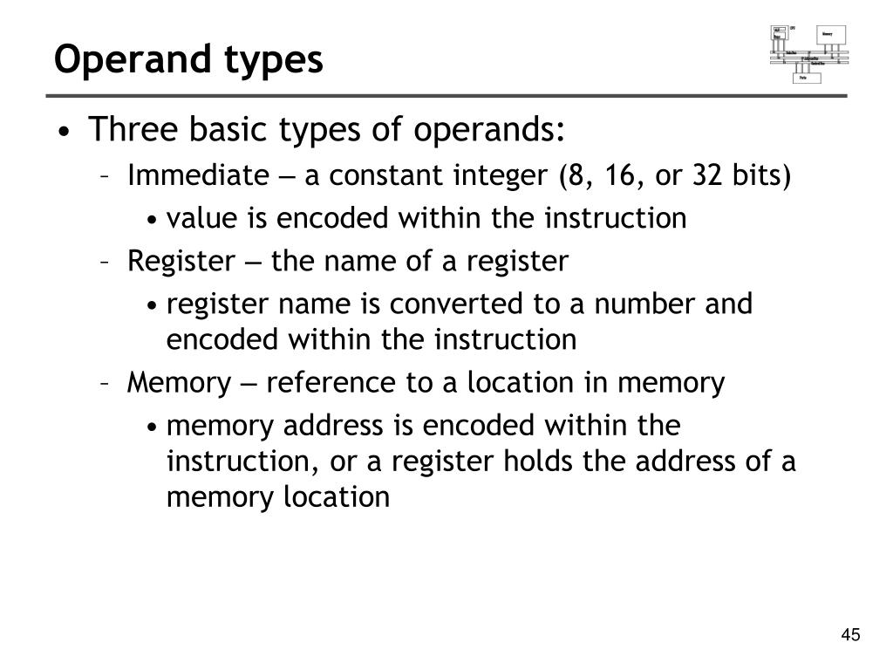
Single pass Assembler for Intel x86

Slide 39
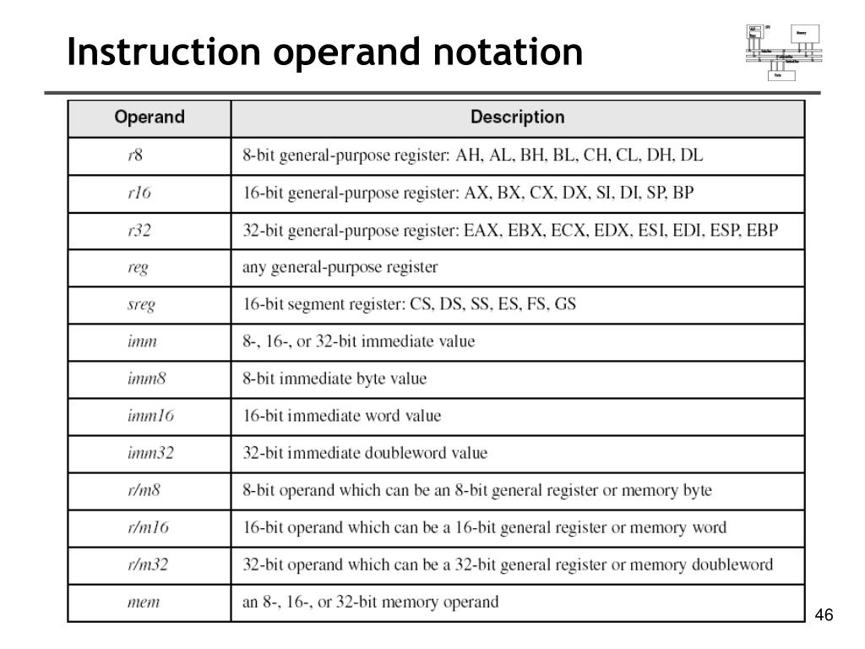
Single pass Assembler for Intel x86
:

Slide 40
Single Pass Storage algorithm
Algorithm for Pass 1 assembler:
begin
if starting address is given LOCCTR = starting address; else LOCCTR = 0;
while OPCODE != END do ;; or EOF begin read a line from the code if there is a label
if this label is in SYMTAB, then error else insert (label, LOCCTR) into SYMTAB
search OPTAB for the op code if found LOCCTR += N ;; N is the length of this instruction (4 for MIPS) else if
this is an assembly directive update LOCCTR as directed else error write line to intermediate file
end
program size = LOCCTR - starting address; end

Slide 41
References
PPT - Intel x86 Assembly Fundamentals PowerPoint Presentation, free download - ID:4403217 (slideserve.com)
Introduction to software | computer Software (w3htmlschool.com)
Types of Software – GeeksforGeeks

Slide 42
Single Pass Storage algorithm
One-pass assemblers are used when
it is necessary or desirable to avoid a second pass over the source program the external storage for the intermediate file between two passes is slow or is inconvenient to use Main problem: forward references to both data and instructions.
Data Structures Required are:
Op code table
Symbol table
pass 1: loop until the end of the program 1. Read in a line of assembly code 2. Assign an address to this line increment N (word addressing or byte addressing)
3. Save address values assigned to labels in symbol tables
4. Process assembler directives constant declaration space reservation

Slide 43

THANK YOU

